Slide 1
|| SHRI RAM ||
ASTRO RENOVATIONS
FOR
ANSHUL & RAJAN PRATHANIA ‘S
RESIDENCE

Slide 2
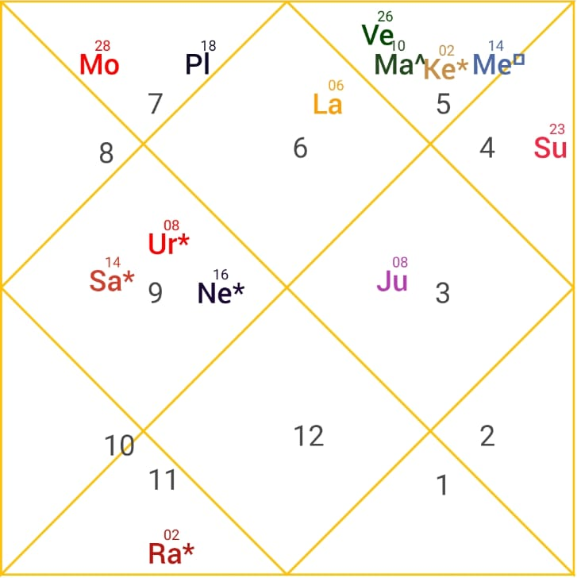
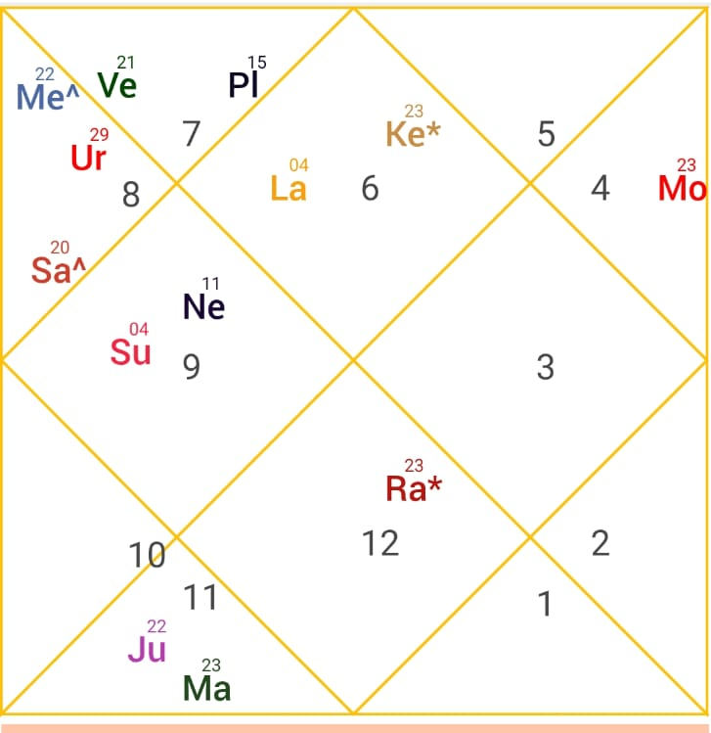
NATAL CHART ANALYSIS FOR PROCEEDING WITH RENOVATION PROPOSALS
ANSHUL’S HOROSCOPE
RAJAN ’S HOROSCOPE

Slide 3
HOUSE FRONT AND VERANDAS
As both Rajan and Anshul have Mercury influencing the 1st House, which governs the entrance and first impression of the home, the following enhancements are recommended:
Introduce greenery and decorative planters near the main entrance to strengthen Mercury's positive energy.
Avoid parking vehicles directly in front of the entrance wherever possible, ensuring an open and welcoming approach.
Incorporate light green tones in the entrance area, creating a harmonious balance between astrological alignment and aesthetic appeal.
Install traditional green hanging lights or lanterns to enhance vibrancy, positivity, and visual charm.
Maintain a clean, well-organized, and naturally illuminated entrance to encourage the flow of positive energy and opportunities.
These subtle modifications require no structural changes while enhancing both the visual appeal of the space and its alignment with Mercury's beneficial energies

Slide 4
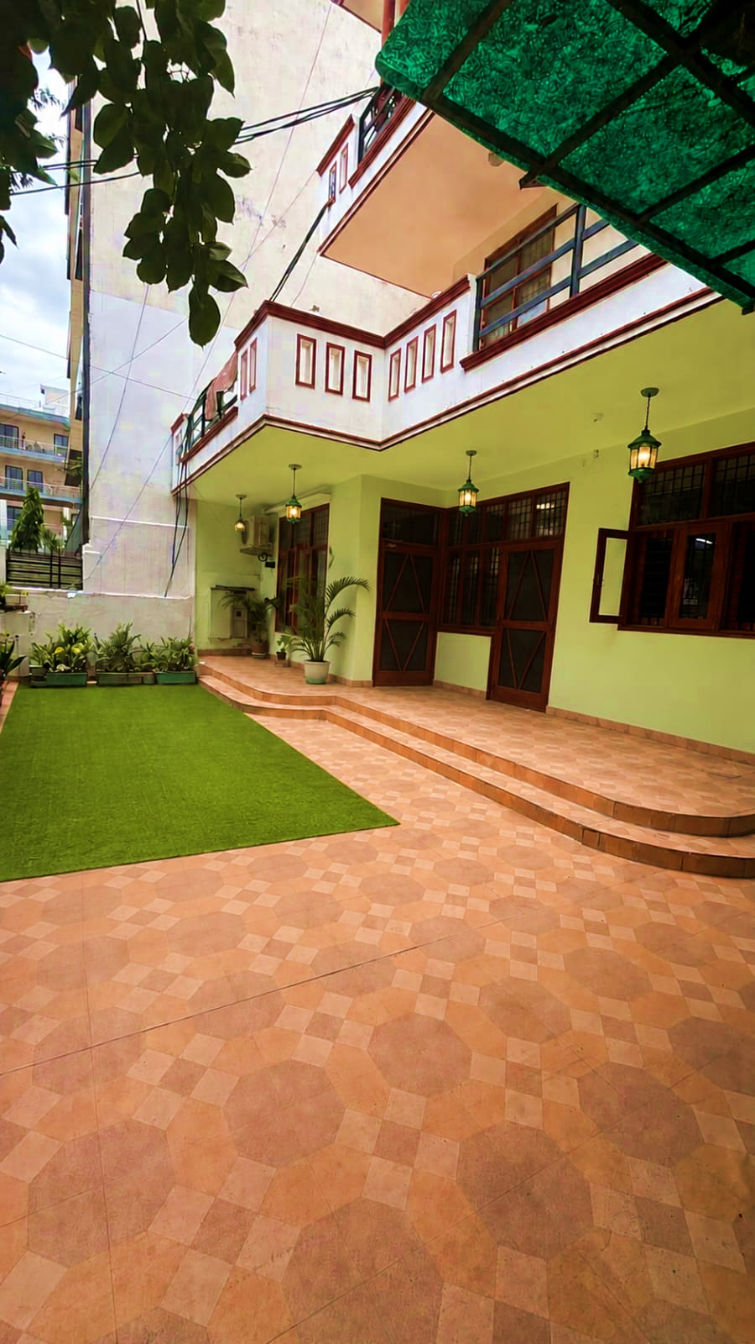
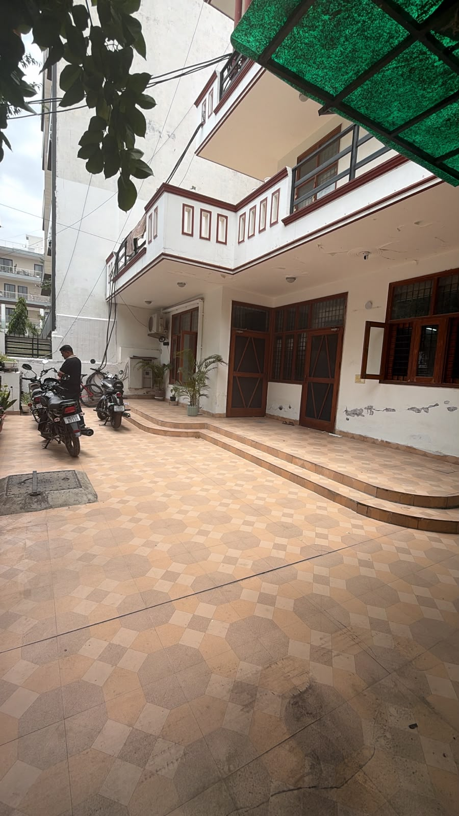
PROPOSED HOUSE FRONT
EXISTING HOUSE FRONT

Slide 5
MAIN ENTRANCE
To Enhance Positive Mercury Alignment and Good Luck Factors
For the main entrance door, we propose the following enhancements to strengthen Mercury-related energies while maintaining an elegant and aesthetically pleasing appearance:
• Paint the main entrance wall in a light green shade to enhance Mercury's positive vibrations and create a welcoming ambiance.
• Install a picture of Lord Ganesha on the side wall with appropriate accent lighting to invite wisdom, protection, and auspicious beginnings.
• Add a traditional green mango-leaf Bandanwar (Toran) above the door to symbolize prosperity, positivity, and good fortune. Adding a plant with herbal smell
• Introduce decorative green wall lights to enhance the visual appeal of the entrance and reinforce Mercury's energy through color and illumination.
These non-structural enhancements are designed to improve the flow of positive energy, prosperity, harmony, and well-being while preserving the aesthetics of the home.

Slide 6
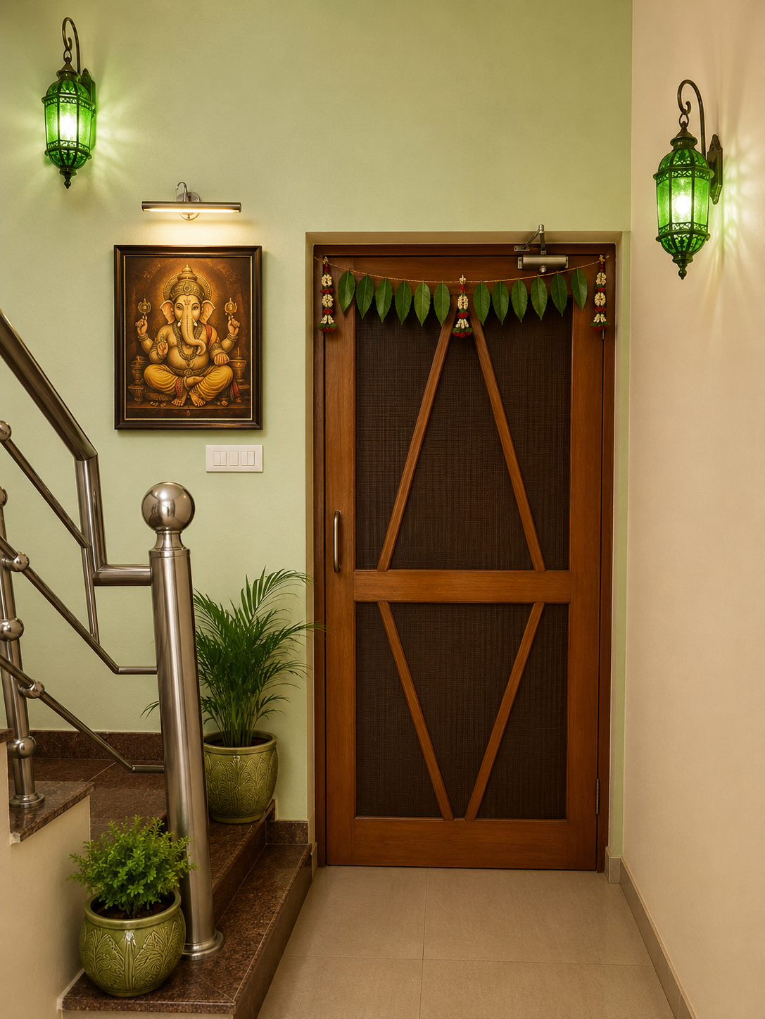
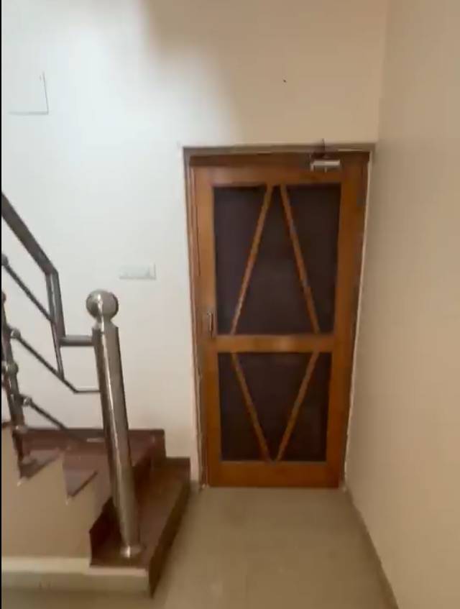
EXISTING MAIN DOOR
PROPOSED MAIN DOOR

Slide 7
KITCHEN RECOMMENDATIONS
Rajan has Venus in the 2nd House and Anshul has Moon in the 2nd House. As the 2nd House represents the kitchen, we recommend the following enhancements to strengthen positive energies, harmony, nourishment, and well-being:
• Change the shade of cabinets from brown to white to create a brighter, cleaner, and more harmonious environment.
• Install warm white LED lights below overhead cabinets to improve functionality and enhance the overall ambience.
• Add decorative blinds above the windows, preferably with subtle floral or botanical patterns, to soften the space and bring visual balance.
• Introduce self-supporting white shelves for organized storage and an elegant appearance.
• Place healthy indoor plants in white planters to add freshness, vitality, and a calming natural element.
• Maintain a clean, clutter-free kitchen environment to support positive energy flow and overall well-being.
• Use a mild rose fragrance or natural rose aroma diffuser to create a pleasant and welcoming atmosphere aligned with Venus's qualities of beauty, comfort, and harmony.
These non-structural enhancements are designed to improve the aesthetics, functionality, and energetic balance of the kitchen while maintaining a refined and contemporary look

Slide 8
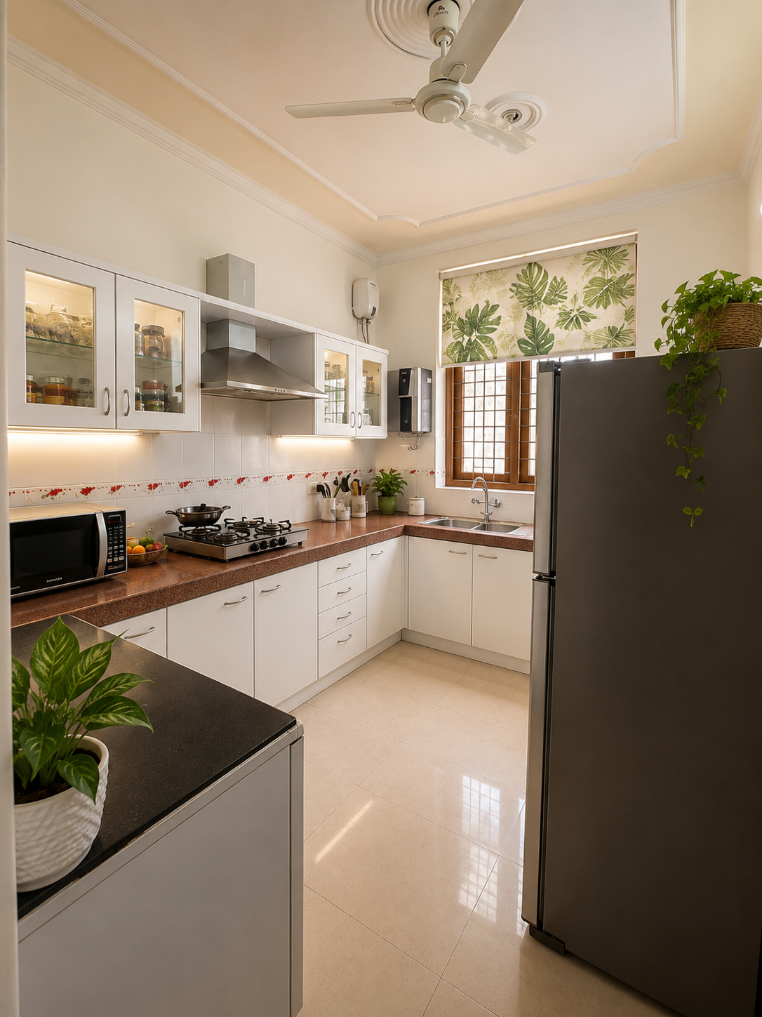
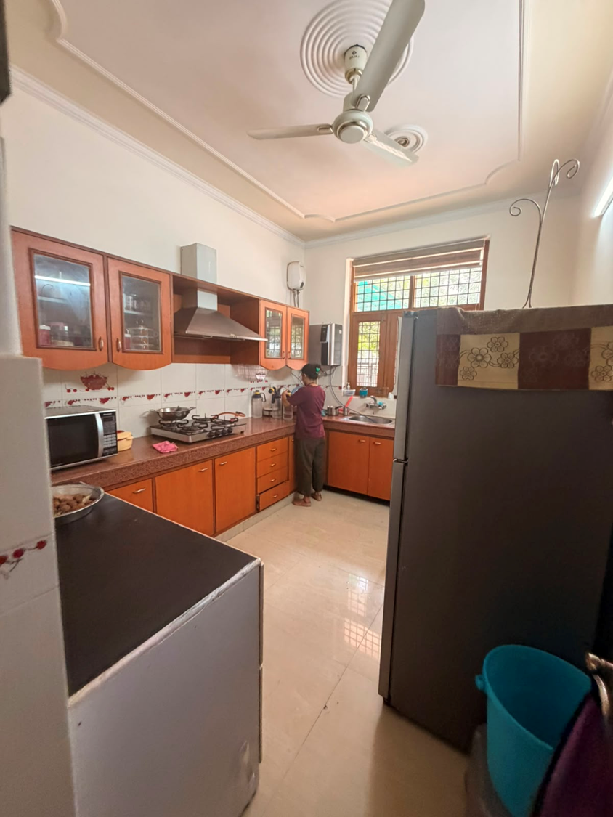
PROPOSED KITCHEN
EXISTING KITCHEN

Slide 9
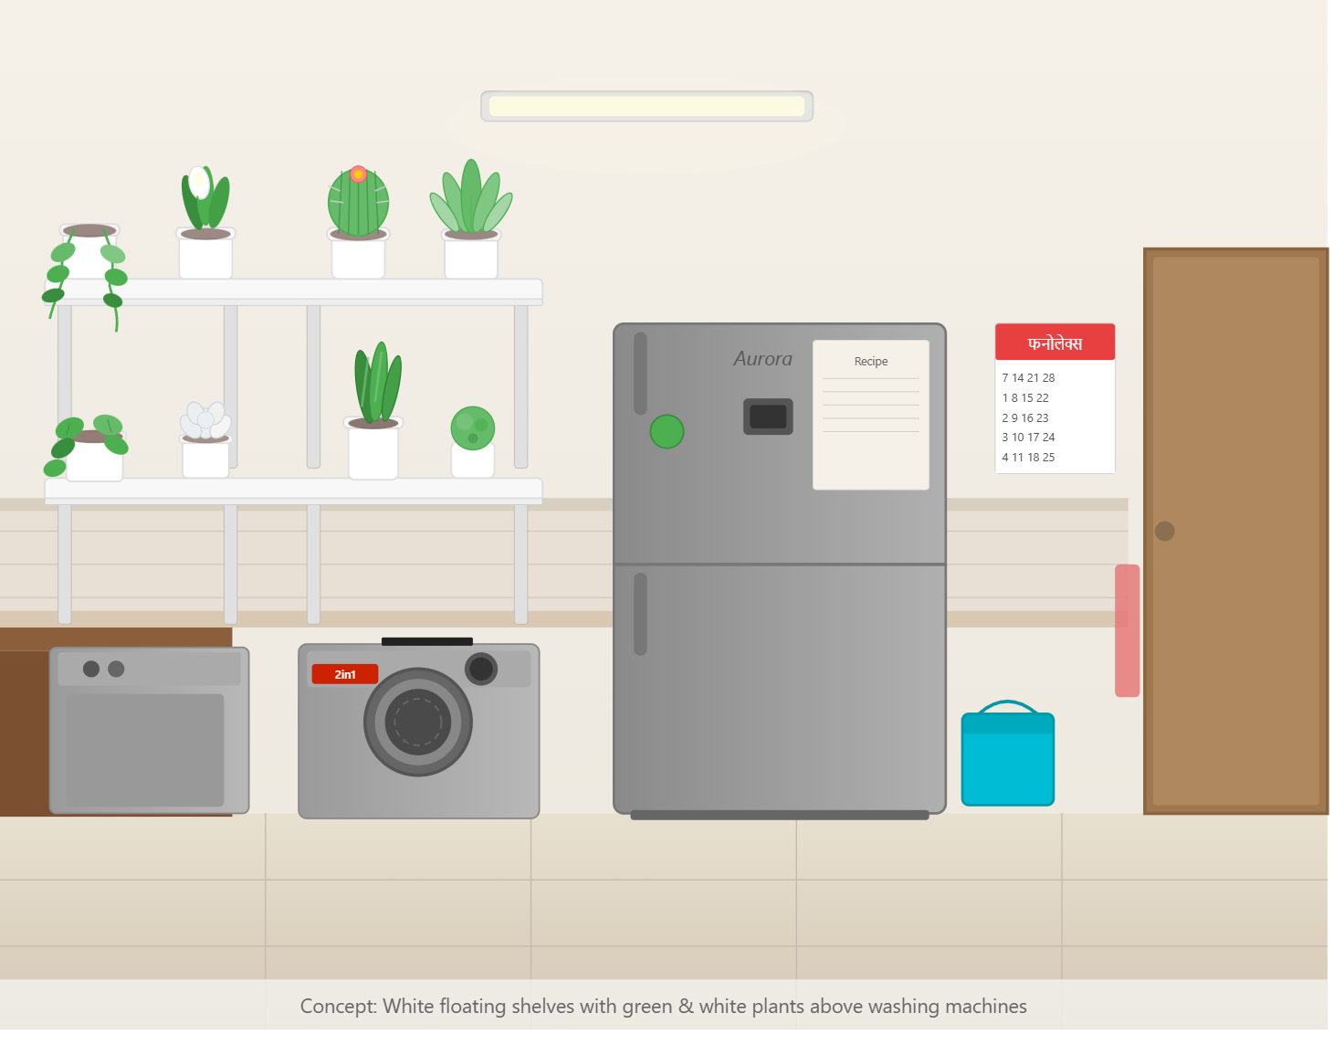
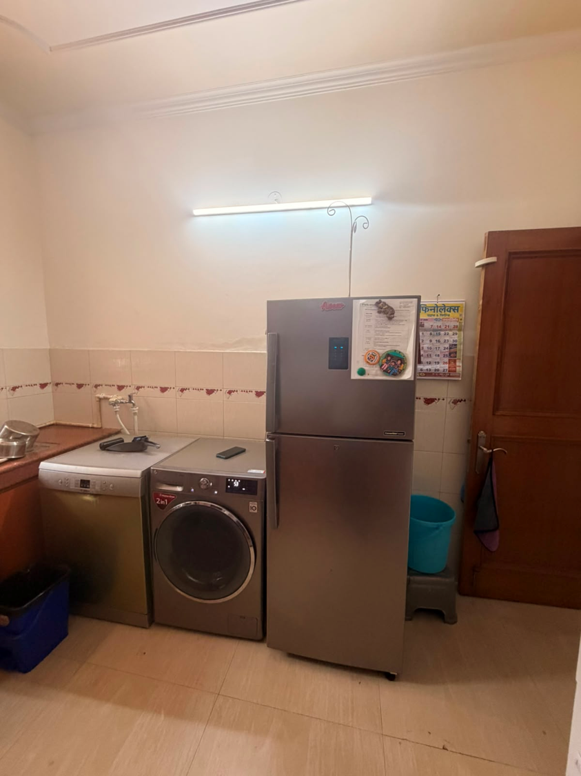
PROPOSED KITCHEN
EXISTING KITCHEN

Slide 10
MASTER BEDROOM
Both Rajan's and Anshul's 7th House are influenced by Jupiter, and Rajan also has Rahu in the 7th House. Introducing a yellow-based colour palette along with brass accents can help strengthen harmony, partnership, mutual understanding, and positive relationship energy.
Recommended Enhancements:
Change wardrobe finish from dark brown to soft cream with elegant brass handles.
Introduce subtle accents of yellow and blue through décor, accessories, or wardrobe detailing.
Install a yellow and blue feature wallpaper on the wall behind the bed to enhance warmth, positivity, and communication.
Use cream and yellow bedsheets, duvet covers, and cushions for a balanced and uplifting ambience.
Reupholster the study chair in a rich blue fabric to add a complementary colour accent and visual balance.
Add brass-finished décor elements, such as lamps, picture frames, drawer pulls, or accent accessories, to strengthen Jupiter-related energies.
Consider warm-white lighting to enhance the cream, yellow, and brass palette and create a welcoming atmosphere.
Expected Benefits:
Improved relationship harmony and understanding.
Enhanced partnership support and cooperation.
Greater positivity, optimism, and emotional warmth in the bedroom.
A more refined, elegant, and luxurious interior environment.

Slide 11
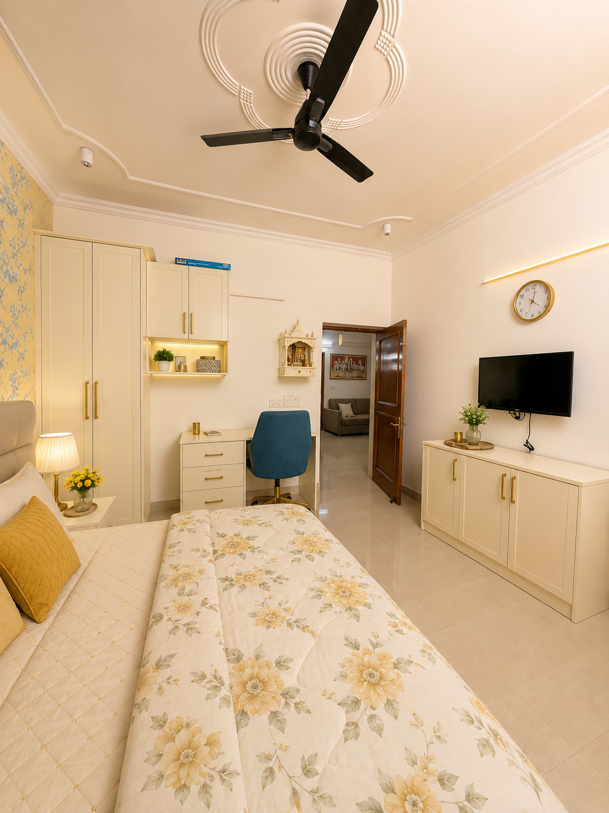
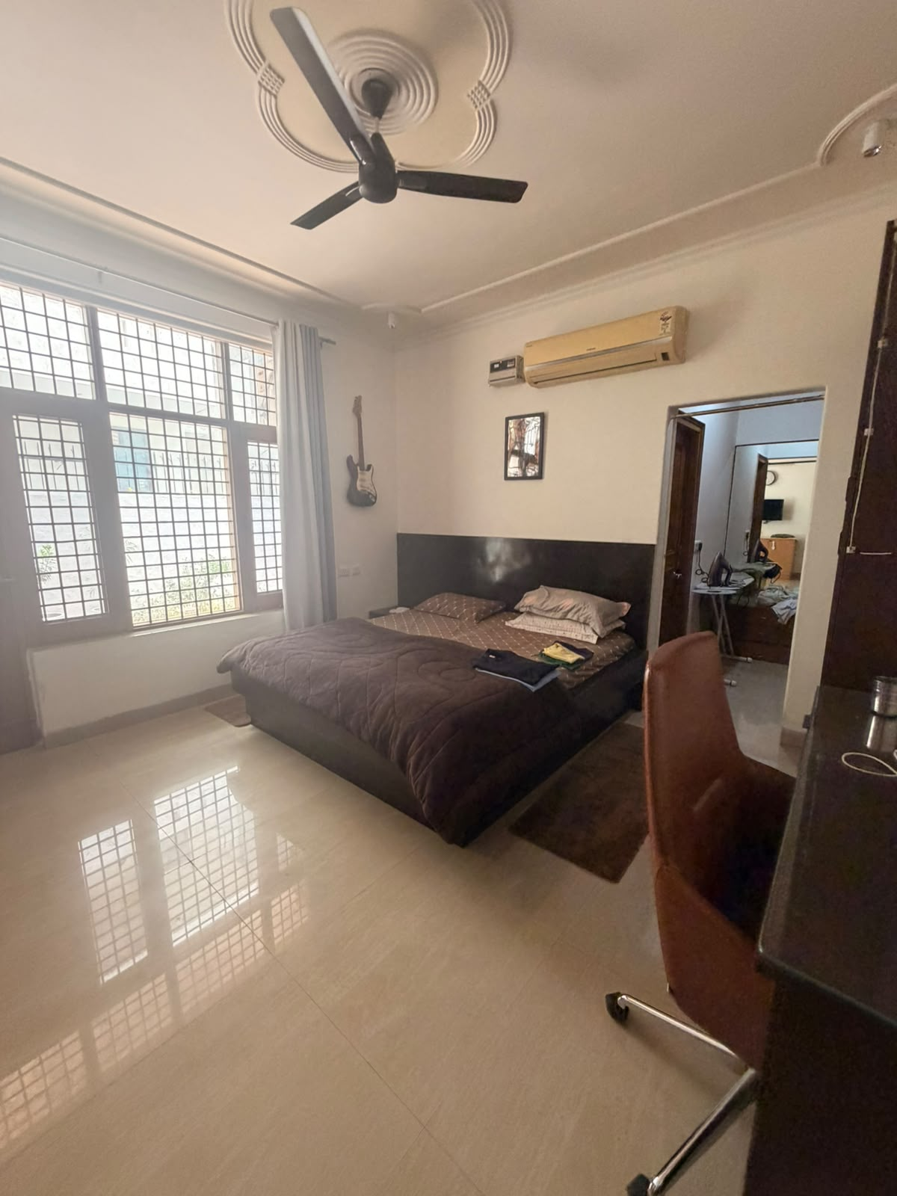
existing
PROPOSED BEDROOM

Slide 12
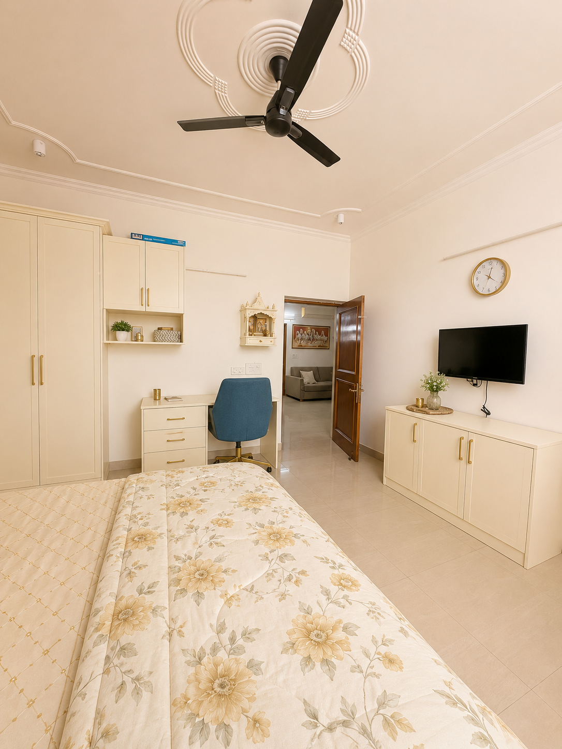
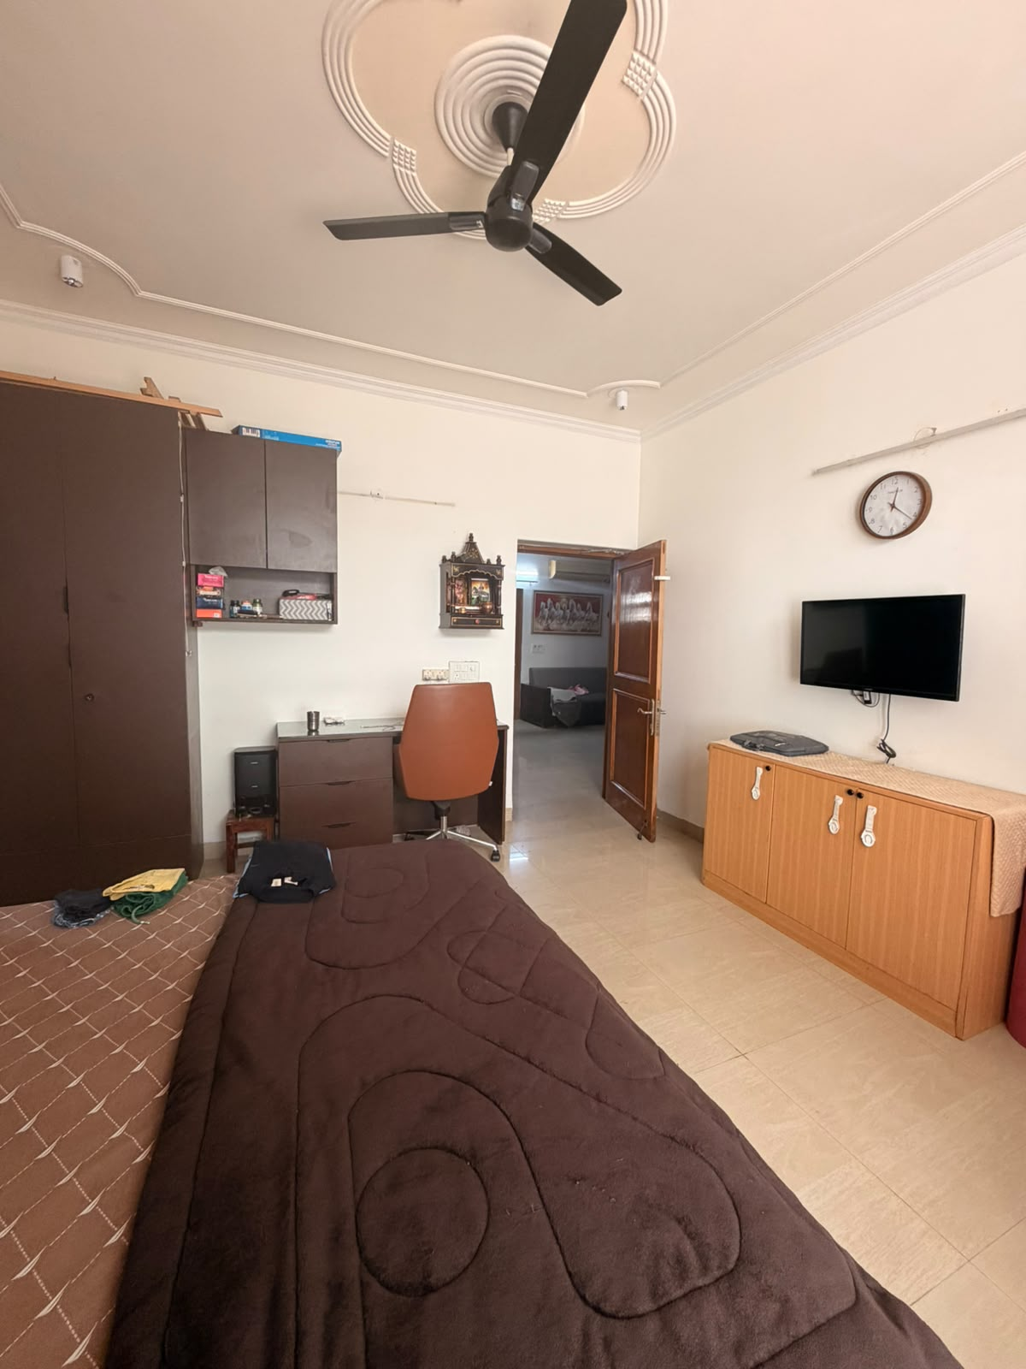
EXISTING
PROPOSED BEDROOM

Slide 13
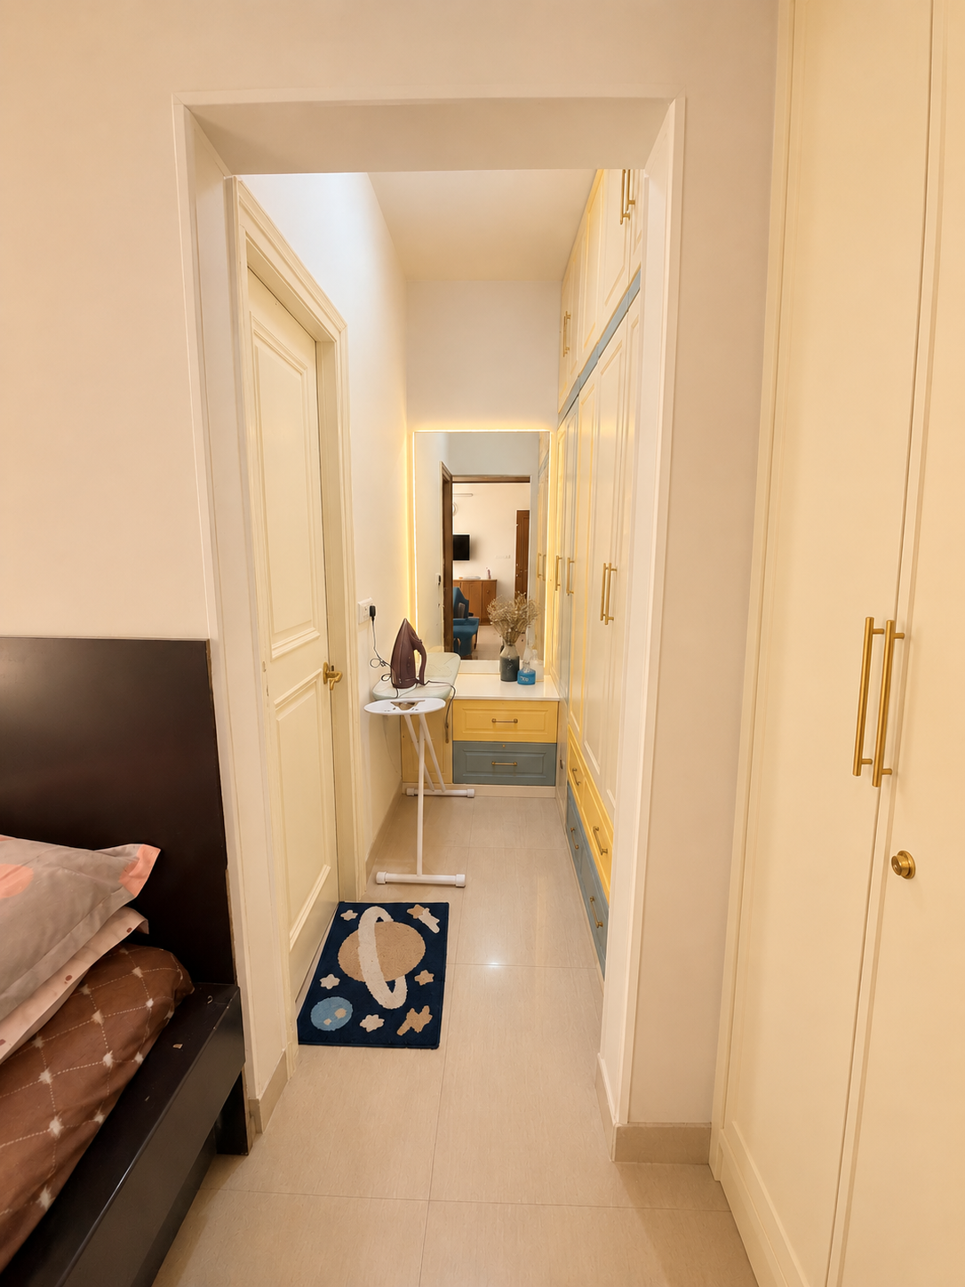
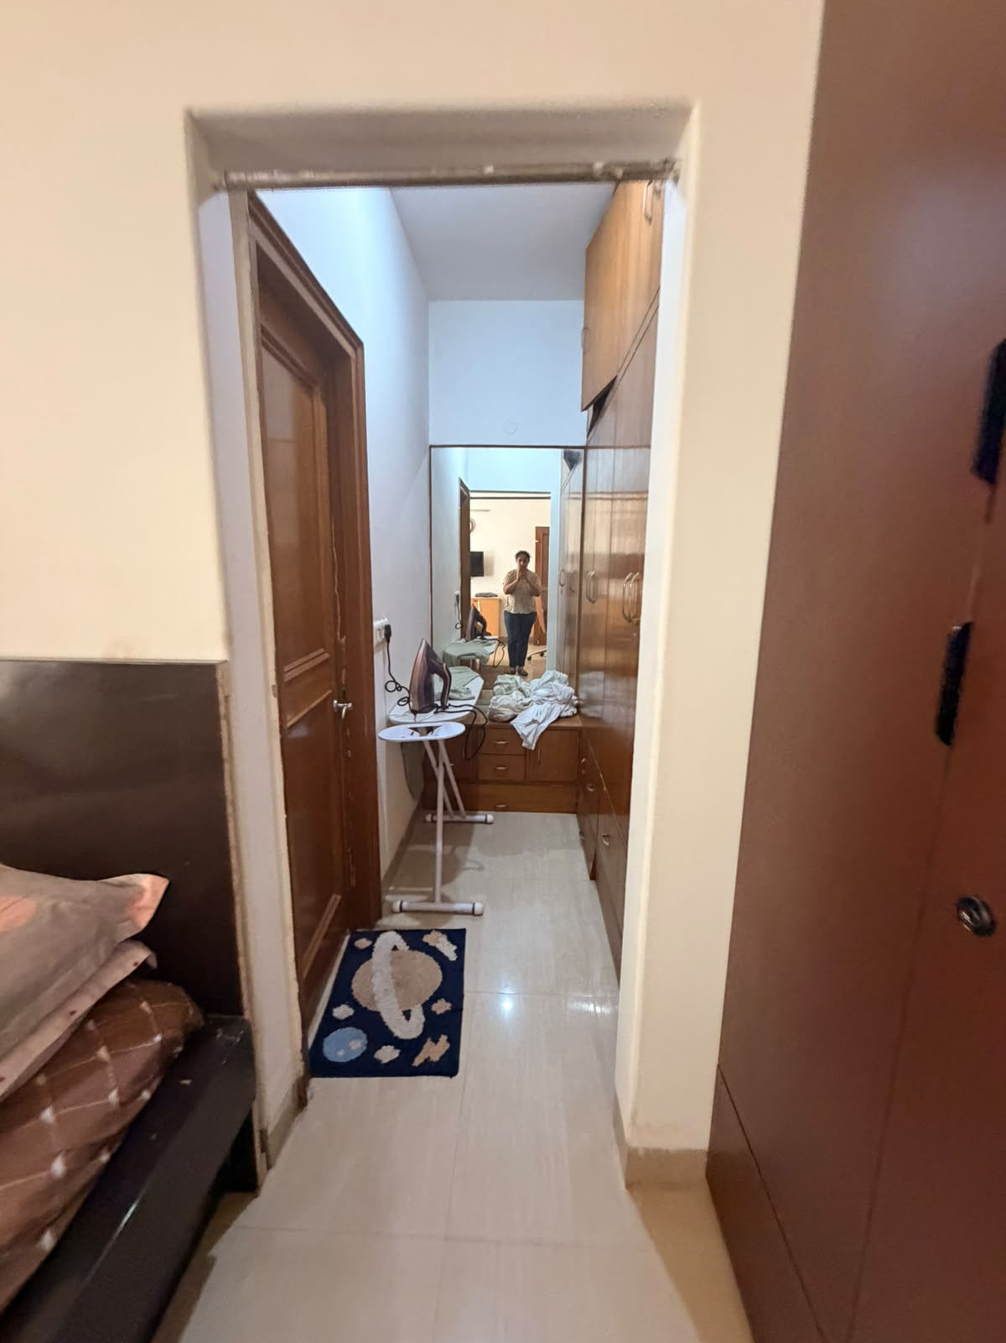
existing
PROPOSED BEDROOM

Slide 14
SON BEDROOM
Both Rajan's and Anshul's 5th House are influenced by Jupiter. The 5th House is associated with children, creativity, learning, joy, and self-expression, while the Sun represents vitality, confidence, and growth. For the 2-year-old boy's bedroom, we have incorporated playful themes inspired by the giraffe and lion, symbolizing curiosity, courage, vibrancy, and joyful development.
Design Recommendations:
The flooring has been changed to a warm teak wood finish, creating a natural and comfortable environment for the child.
A playful area rug has been added to encourage activity, comfort, and creativity.
The furniture has been designed in a soft cream shade to create a bright, calming, and timeless base.
Accents of yellow and orange have been introduced to promote positivity, enthusiasm, happiness, and creative energy.
Animal-themed décor featuring giraffes and lions adds a sense of adventure, imagination, and playfulness suitable for a growing child.
Accent lighting and warm ambient lights are recommended to enhance brightness, create a cheerful atmosphere, and highlight key design elements.
Expected Benefits
These recommendations are intended to create a nurturing, joyful, and stimulating environment that supports the child's creativity, confidence, learning, and overall well-being. The balanced use of colors, materials, lighting, and symbolic elements helps establish a positive and vibrant space for healthy growth and development.

Slide 15
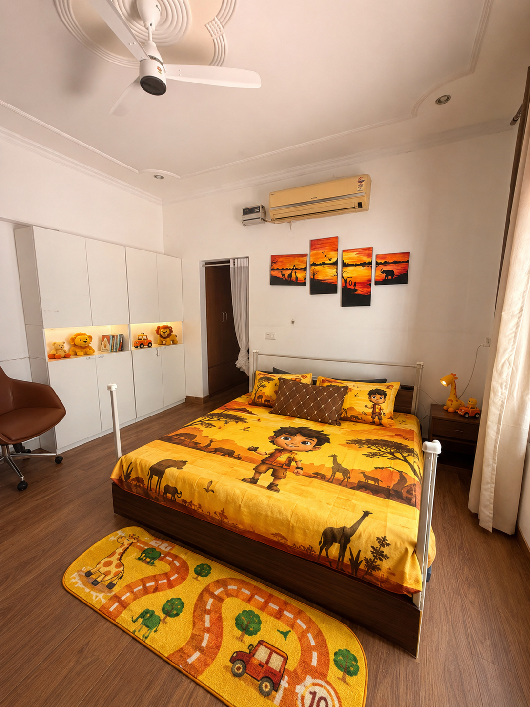
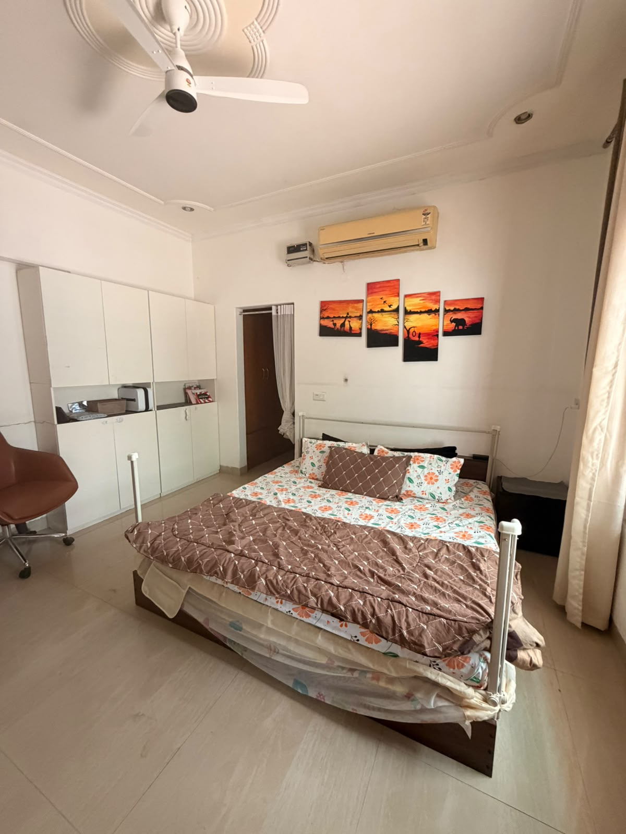
existing
PROPOSED SONS ROOM

Slide 16
DRAWING ROOM
Anshul has a strong influence of the Sun, while Rajan has the influence of Saturn in the 4th House, which governs the living and drawing room areas of the home. Although the Sun and Saturn are traditionally considered opposing planetary energies, when balanced thoughtfully through design, they can create a harmonious environment that combines warmth, structure, elegance, and stability.
To achieve a modern décor with the right blend of sophistication and comfort, we recommend the following:
Introduce a modern black sofa to represent Saturn's strength, stability, and timeless elegance.
Use bright cream and orange cushions to bring in the Sun's warmth, positivity, and vibrant energy.
Install white wooden flooring to create a brighter, more spacious, and contemporary appearance.
Add a modern floor rug to enhance comfort and visually anchor the seating area.
Incorporate layered lighting to create a welcoming ambiance and highlight key design elements.
Place an appropriate traditional artwork, such as a classic Indian painting, above the sofa to create a beautiful fusion of heritage and modernity.
Expected Benefits
The combination of black, cream, and orange tones creates a balanced interplay between the disciplined energy of Saturn and the vibrant energy of the Sun. The recommended design elements help establish a living space that feels elegant, welcoming, and refined while promoting harmony, family bonding, and a sense of pride in the home. The addition of traditional artwork further enriches the space by blending cultural richness with contemporary aesthetics

Slide 17
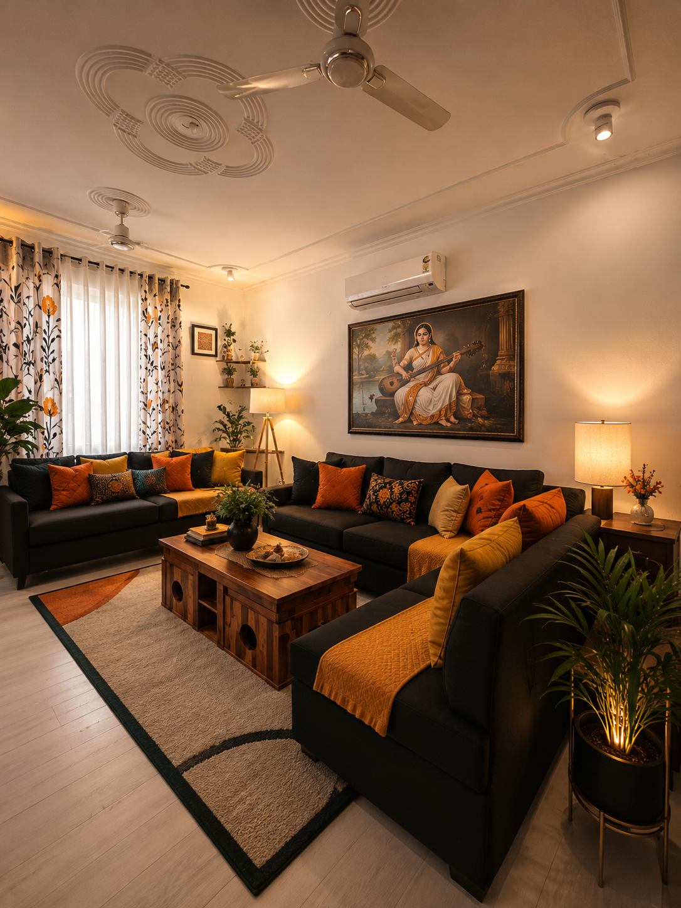
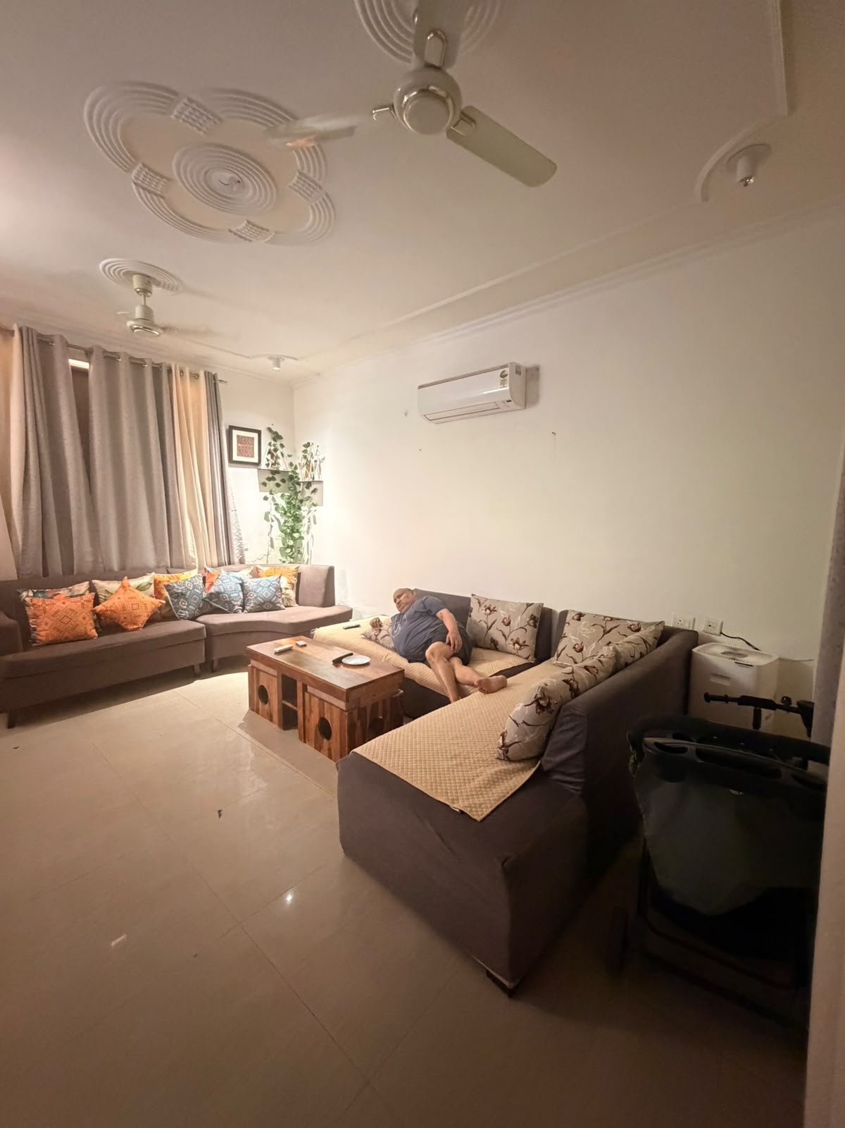
existing
PROPOSED DRAWING ROOM

Slide 18
GUEST ROOM
Anshul has a strong influence of the Sun, while Rajan has the influence of the Moon in the 11th House, which governs guest rooms and baithak areas. The Sun and Moon are friendly planets and together create a harmonious balance of warmth, comfort, positivity, and social connection.
To enhance these beneficial planetary influences, the following design elements have been incorporated:
• Cream and orange themed wallpaper to create a warm, welcoming, and uplifting ambience.
• Sunrise artwork positioned behind the bed to strengthen the positive energy of the Sun and encourage vitality and optimism.
• Cream upholstered bed with rust-orange runners, creating a balanced blend of elegance and warmth.
• Silver accessories and décor accents to amplify the calming and nurturing qualities of the Moon.
These carefully selected colours, materials, and décor elements help create a guest room that promotes comfort, positivity, harmonious relationships, and memorable experiences for visitors.

Slide 19
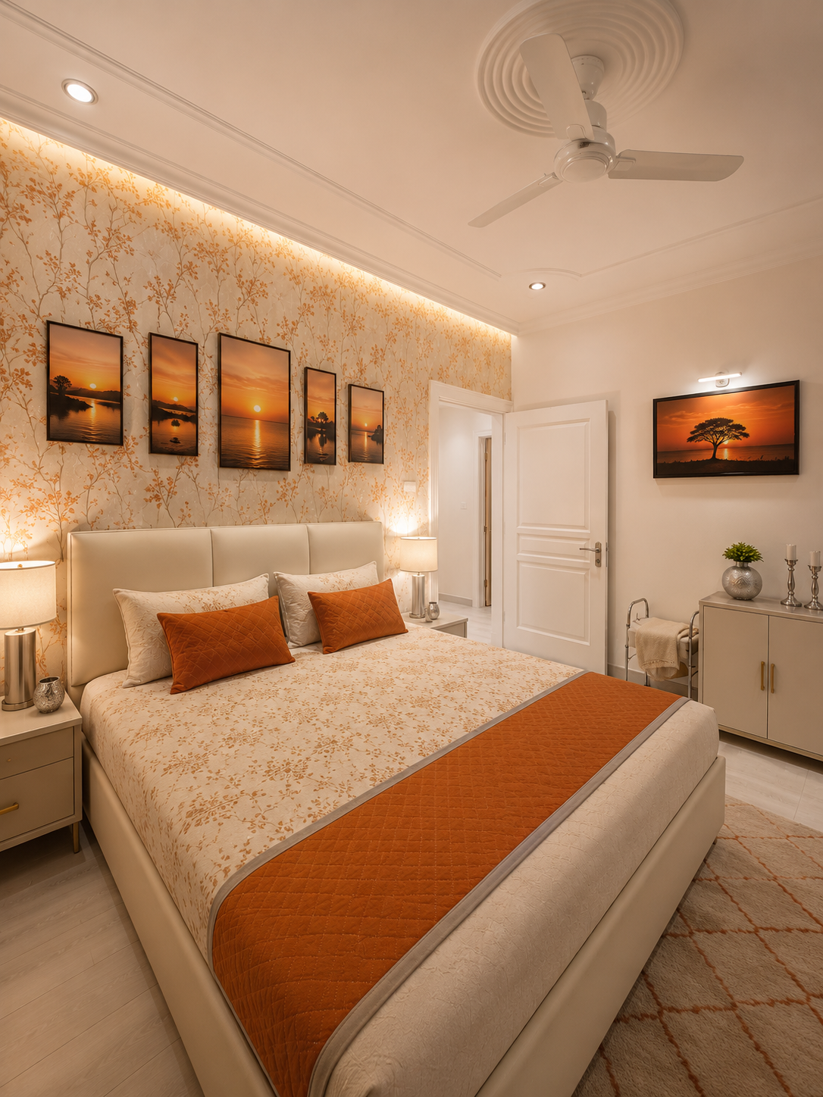
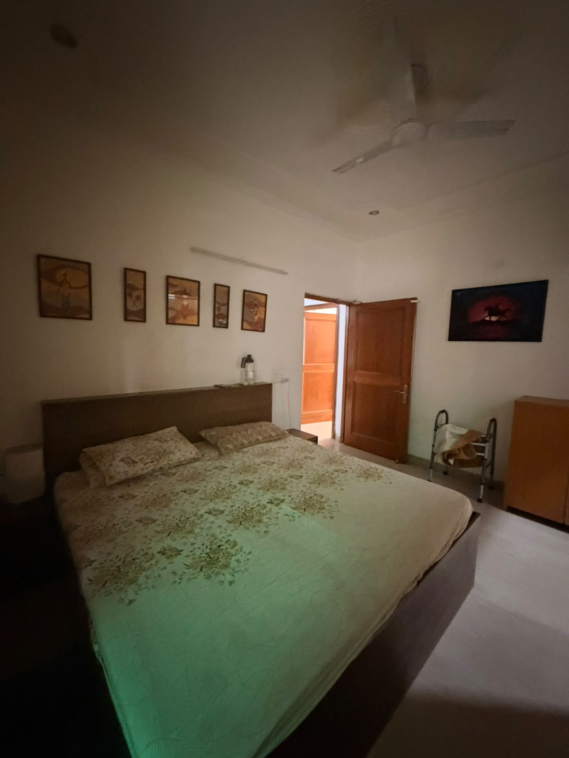
existing
PROPOSED GUEST ROOM

Slide 20
BACK YARD / MEDITATION ZONE
The 12th House in a horoscope symbolizes the backyard and areas associated with peace, spirituality, relaxation, and meditation. Both Anshul and Rajan have the influence of the Sun in the 12th House. Additionally, Anshul has the influence of multiple planets, including Mars, Mercury, Venus, and Ketu, in this house.
To create a harmonious balance of these planetary energies and enhance the overall well-being of the occupants, the following recommendations have been incorporated:
• A dedicated meditation area has been created in the backyard to encourage relaxation, mindfulness, and spiritual growth.
• A soothing maroon and cream colour palette has been introduced to create a warm, grounding, and tranquil atmosphere.
• Abundant greenery has been added to strengthen the positive influence of Mercury and Venus while enhancing the connection with nature.
• Soft ambient lighting has been incorporated to create a peaceful environment suitable for meditation and evening relaxation.
• Decorative pebbles and natural landscape elements have been introduced to promote balance, stability, and positive energy flow throughout the space.
These carefully selected design elements help transform the backyard into a serene retreat that supports inner peace, rejuvenation, and spiritual well-being while harmonizing the planetary influences present in both horoscopes.

Slide 21
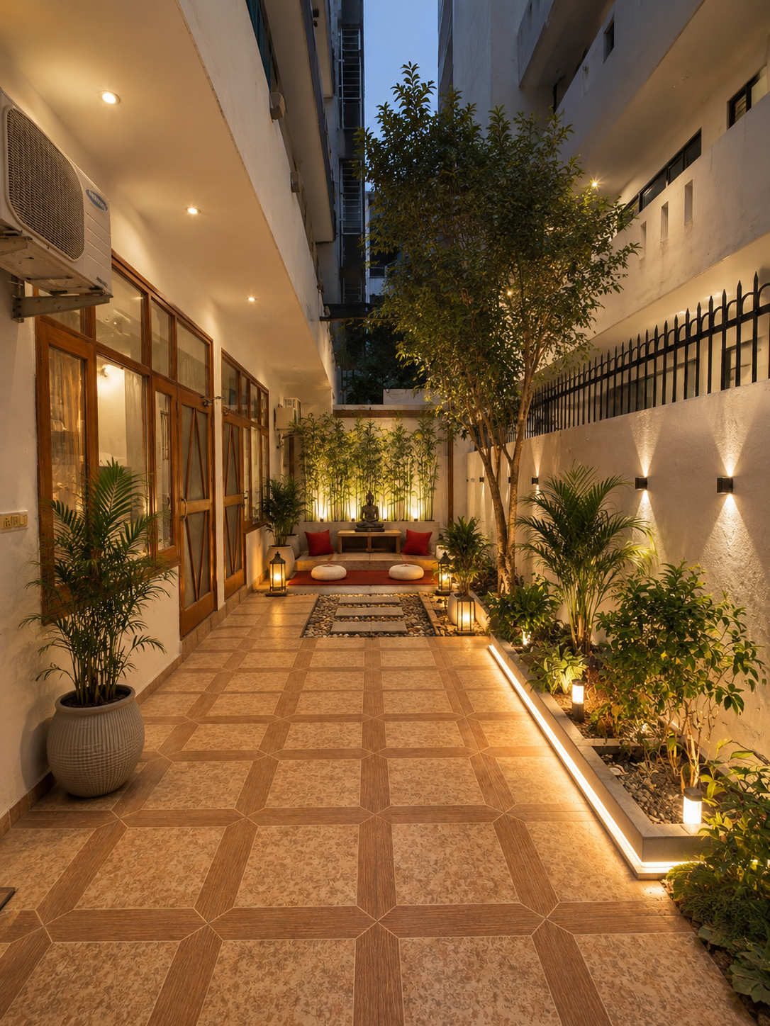
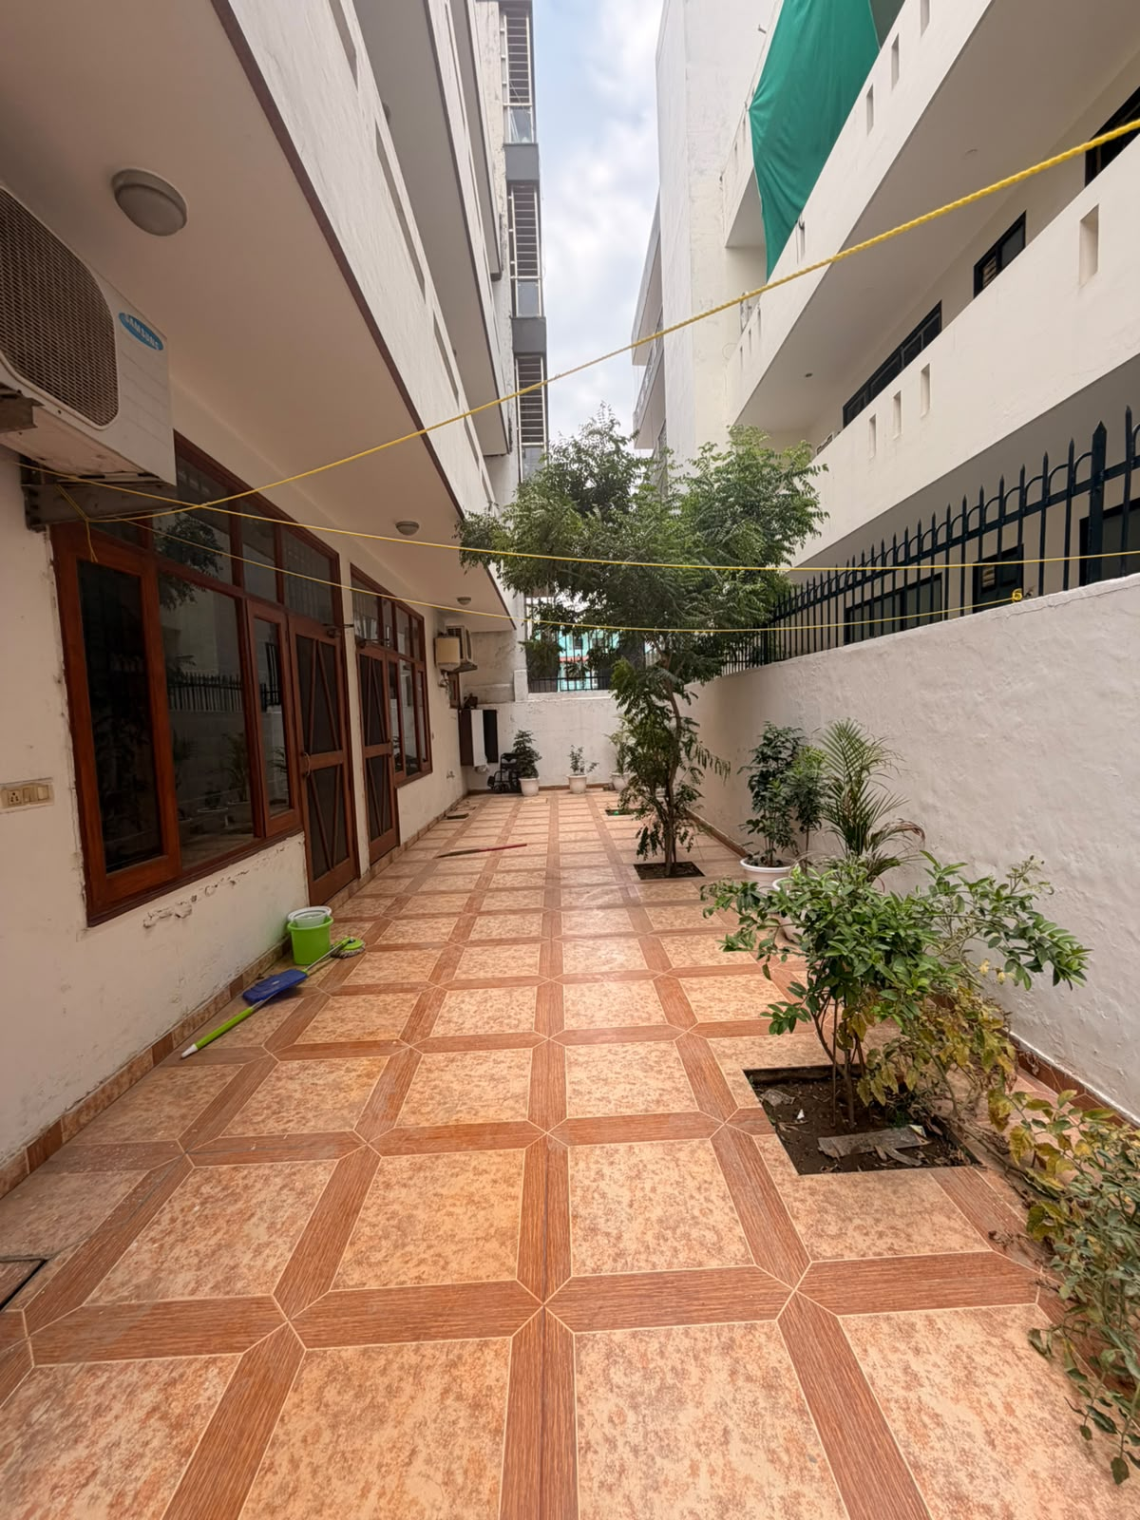
existing
PROPOSED BACKYARD

Slide 22
COMMON AREA / DINING AREA
In the case of Anshul and Rajan, the Common Area and Dining Area are governed by the 3rd House. In both horoscopes, this house is influenced by Mars, while Anshul also has the influence of Mercury and Saturn in the 3rd House.
To harmonize and enhance these planetary influences, the following design recommendations have been incorporated:
• A rich maroon velvet sofa has been introduced to strengthen the positive energy of Mars while adding warmth, elegance, and vitality to the space.
• The children's play area has been enhanced with maroon-themed animal cartoon cut-outs, creating an energetic, creative, and engaging environment for young minds.
• Soft shades of green have been introduced on the walls to amplify the beneficial influence of Mercury, promoting communication, learning, and mental clarity.
• The dining area has been elevated with bronze cutlery and decorative accents, bringing sophistication, stability, and prosperity to family gatherings and social interactions.
• Additional lighting has been incorporated to create a bright, welcoming ambience and improve the overall flow of positive energy.
• The space has been thoughtfully decluttered to promote harmony, ease of movement, and a sense of openness and abundance.
Together, these carefully selected colours, materials, and décor elements create a balanced and vibrant common area that encourages communication, family bonding, creativity, prosperity, and overall well-being.

Slide 23
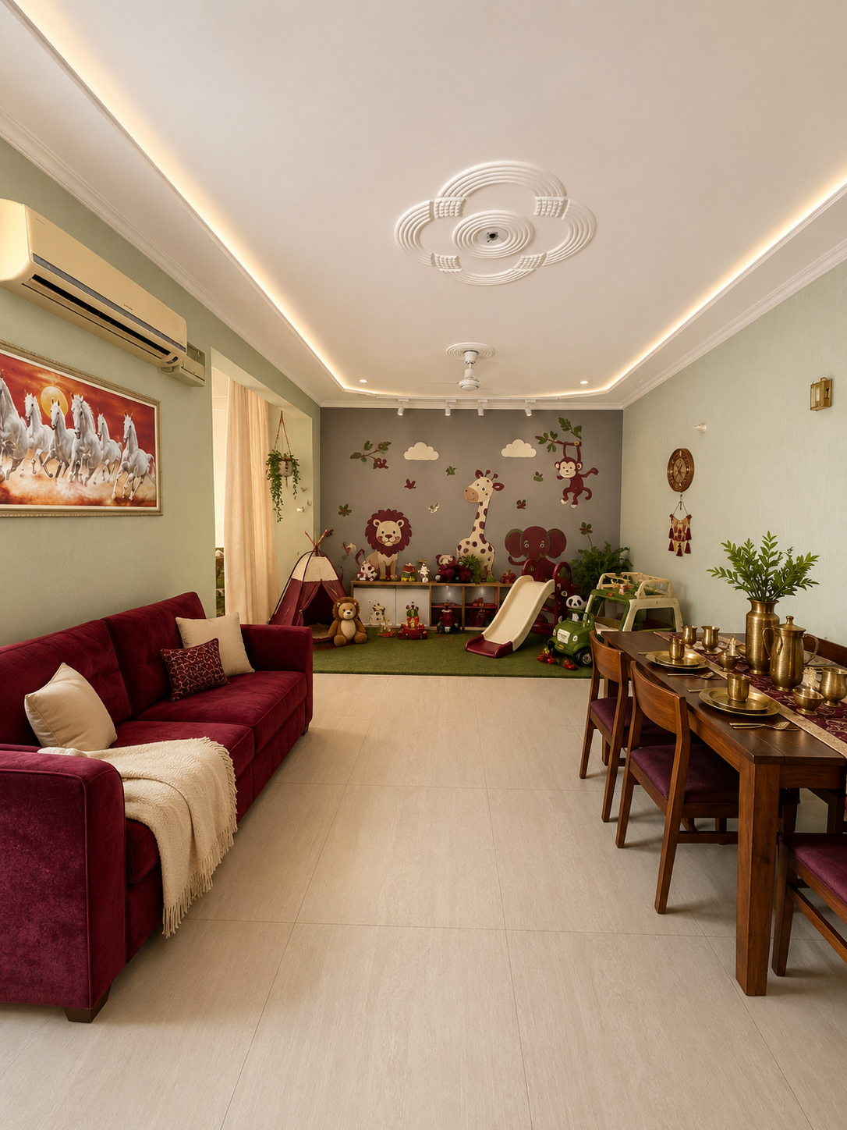
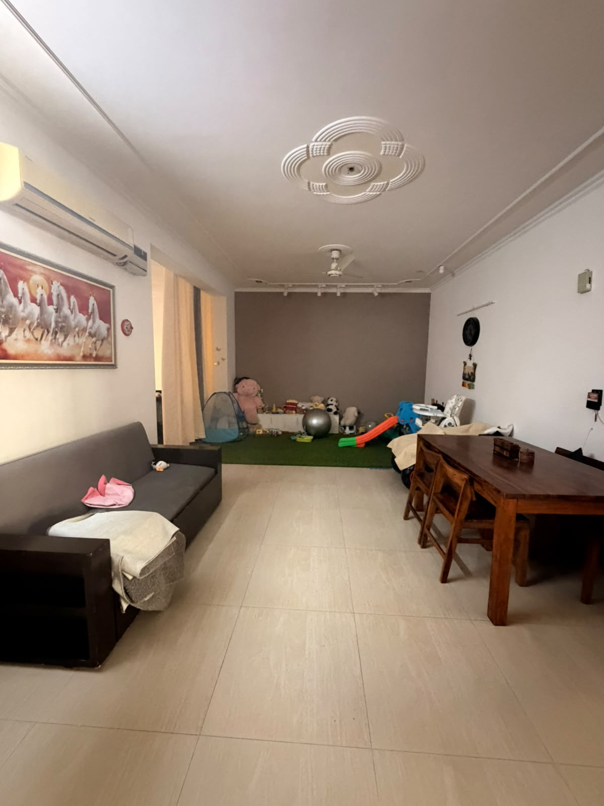
existing
PROPOSED COMMON AREA

Slide 24
|| SHRI RAM ||
ACKNOWLEDGEMENT
We would like to sincerely thank Anshul and Rajan for placing their trust in Transcend Astro and for being among our very first clients. Your faith, encouragement, and support have played an invaluable role in the beginning of this journey.
It has been our privilege to create this personalized Astro-Interior proposal for your home, blending the principles of astrology with thoughtful interior design to enhance harmony, well-being, and positive energy within your living spaces.
We pray that your home is blessed with prosperity, happiness, abundance, good health, and meaningful relationships for years to come. May every corner of your home radiate positivity, success, and joy for your family.
Thank you for believing in the vision of Astro Interiors and for being an important part of the Transcend Astro story.
With Gratitude and Best Wishes,
Team Transcend Astro

